Slide 1

MAX PLANCK INSTITUTE FOR HEART AND LUNG RESEARCH
Bioinformatics Core Unit

Slide 2
Introduction
Terms and methodology this pipeline is based on.

Slide 3
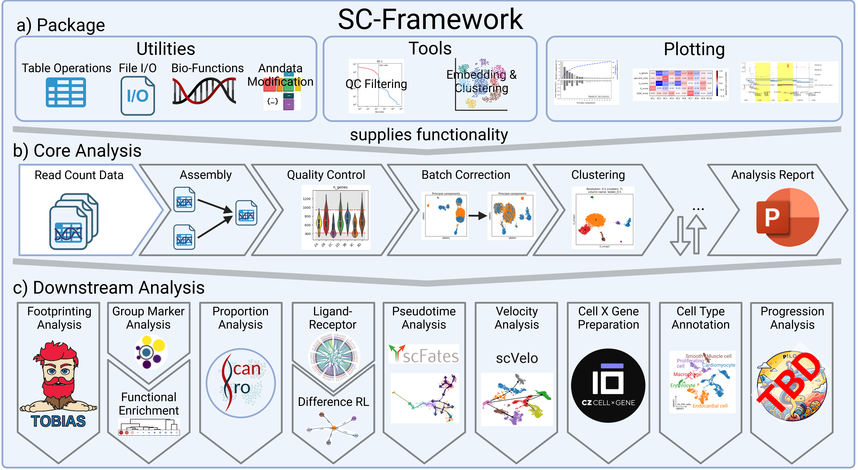
Overview
Manual: https://loosolab.pages.gwdg.de/software/sc_framework/

Slide 4
Terms and Algorithms
Observation (obs)
In scATAC-seq data an observation refers to a cell identified by a barcode unique in the dataset.
Variable (var)
A variable refers to a genomic region. Regions can be formatted in different ways e.g. the genome is split into equal sizes “windows”, each region refers to an open chromatin location or each region contains a promoter. Both var and obs can have additional metadata, e.g. cell types (obs) or “is mitochondrial” (var).
Matrix
The analysis is based on an expression matrix (obs x var) that contains the raw ATAC counts for each cell over each region.
Latent Semantic Indexing (LSI)
LSI is the scATAC analogue to the Principle Component Analysis (PCA). It reduces the high-dimensional data by summarizing similar behaving genes into components. Components that explain little of the dataset variance or ones that correlate with technical factors are considered noise and removed.
t-distributed stochastic neighbor embedding (t-SNE)
The t-SNE further reduces the dimensions (components) from the LSI to a low-dimensional output (usually 2D).
More information on t-SNE
Uniform Manifold Approximation and Projection (UMAP)
UMAP takes the components from the LSI and reduces them into a low-dimensional, 2D or 3D, representation. It does so, by constructing a high-dimensional graph and optimizing a low-dimensional analogue to be as similar as possible. Both UMAP and t-SNE are mostly equivalent techniques to visualize high-dimensional data. They are robust, meaning they will provide highly similar results. Thus, we provide either UMAP or t-SNE.
More information on UMAP

Slide 5
Terms and Algorithms
Batch correction
Batch effects are variances in the data that are not intended by the experimental design (e.g. technical variance). They can be introduced through various sources. For example, sequencing samples at different timepoints may introduce batch effects. As batch effects could interfere with downstream analysis they are typically removed. However, it can be challenging to identify and correct for batch effects as this is highly dependent on the experimental setup of the dataset. For optimal results an experiment should be designed in a way that each condition is present in at least two different batches.
Local Inverse Simpson's Index (LISI)
The LISI measures the strength of a batch effect based on the heterogeneity in each group. Meaning, a well-mixed dataset, without any batch effect will get a high score of up to the number of batches in the dataset.
Clustering
The clustering, typically done using the leiden algorithm, sorts the cells of a dataset into groups based on their expression similarity. The resulting clusters are commonly thought to be cell types and annotated in the following steps.

